Slide 1
On the Origins of Gas Giant Compositions
Ana-Maria Piso
Advisor: Karin Öberg
Collaborators: Ruth Murray-Clay, Til Birnstiel, Andrew Youdin, Jamila Pegues
Thesis Advisory Committee: Matthew Holman, Sean Andrews, Dimitar Sasselov
TAC Meeting Presentation: March 9th , 2016
Notes:
…and what I would like to talk about today is the minimum core mass for giant planet formation. Now, when we think of minimum core mass, we think core accretion. In core accretion, we know that for a giant planet to form it needs a solid core, that grows, and once it becomes massive enough it can then accumulate a significant atmosphere. How big of a core do we need? Well, typically this value is believed to be around 10 Me. However, this is not a constant, and it not only depends on where we are in the disk but also on how fast the core grows. Now why do we care about this? We have seen throughout this week giant planets imaged at wide separations. Now, we don’t know whether these planets formed through core accretion or not; but if they do, and if core accretion works at large separations, then it’s very important to understand how it works, and more importantly to be able to place a robust absolut minimum for a giant planet to form within the lifetime of the protoplanetary disk. And this is what I am going to talk about today.

Slide 2
Outline
Brief Background Info
Research Accomplished Since Last Meeting
Next Steps
Proposed Defense Timeline

Slide 3
Outline
Brief Background Info
Research Accomplished Since Last Meeting
Next Steps
Proposed Defense Timeline

Slide 4
Disk Compositions Regulate Planet Compositions
Understand the disk well enough to:
Predict what kind of planet compositions result from planet formation in different parts of the disk
Back-track the planet formation location based on the planet composition

Slide 5
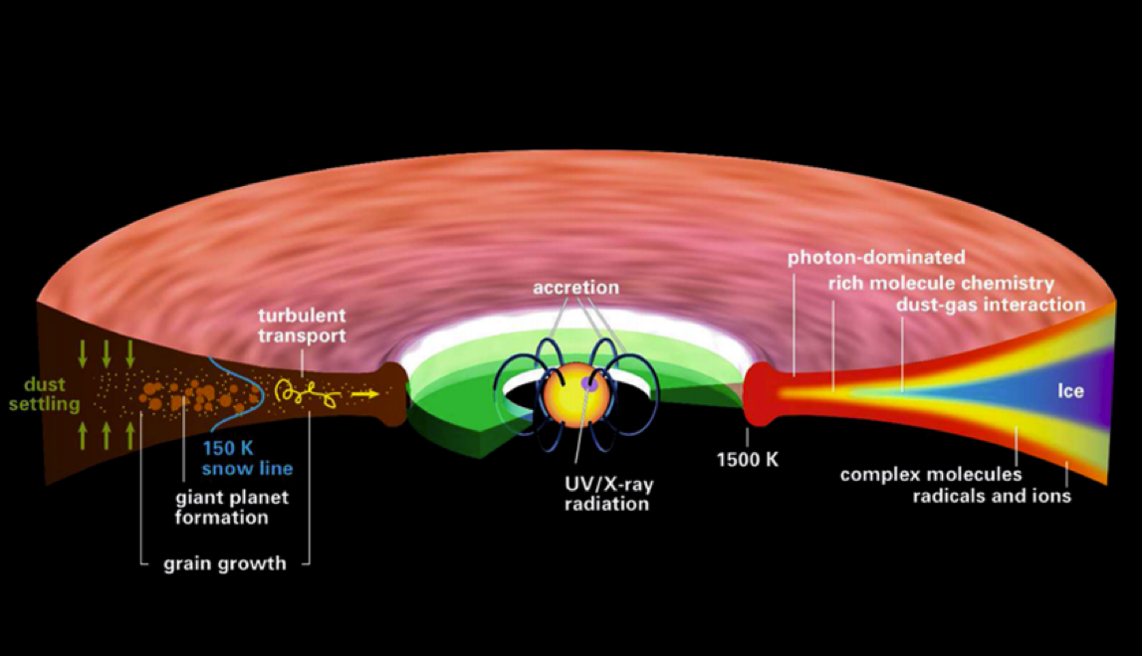
Disk structure is complex!
Henning&Semenov (2013)
Notes:
Remove the while and make the figure bigger.

Slide 6
Outline
Brief Background Info
Research Accomplished Since Last Meeting
Next Steps
Proposed Defense Timeline

Slide 7
Understand how DISK DYNAMICS and ICE MORPHOLOGY affect the snowline locations of the main C, O, N carriers, and thus the C/N/O ratios in gas and dust throughout the disk
GOAL

Slide 8
Piso, A.-M. A., Oberg, K. I., Birnstiel, T., & Murray-Clay, R. A. 2015, ApJ, 805, 109
C/O and Snowline Locations
in Protoplanetary Disks: The Effect of Radial Drift and Viscous Gas Accretion

Slide 9
We determined upper limits for the C/O ratio across the disk
Piso, Oberg, Birnstiel, Murray-Clay (2015)

Slide 10
Paper submitted to be submitted to ApJ by March 11
Piso, A.-M. A., Oberg, K. I., & Pegues, J.
The Role of Ice Compositions and Morphology for Snowlines and the C/N/O Ratios in Active Disks

Slide 11
GOAL
Expand the coupled drift-desorption model of Paper I by considering:
Additional volatile molecules and abundances (CH₄, N₂, NH₃)
Different ice morphologies
N/O and N/C ratios

Slide 12
Assumptions
VOLATILE ABUNDANCES
Some C present in the form of CH₄
Add nitrogen-bearing molecules – nitrogen highly abundant in the Solar System and in disks and primarily found as N₂
Some N present in the form of NH₃
=> Use the median and maximum CH₄ and NH₃ abundances observed in protostellar cores from Spitzer c2d Legacy ice survey (Oberg et al. 2008, Oberg et al. 2011, etc.)
ICE MORPHOLOGY
The binding energies of CO and N₂ vary by a factor of ~1.7 depending on whether CO and N2 are pure or water dominated ices (Fayolle et al. 2016)

Slide 13
More volatile snowlines in disks
Piso, Oberg, Pegues (2016, in prep)

Slide 14
Expected abundances of CH4 do not change C/O results significantly
Piso, Oberg, Pegues (2016, in prep)

Slide 15
N/O ratios may be used as tracers of atmospheric chemistry
Piso, Oberg, Pegues (2016, in prep)

Slide 16
Disk dynamics and ice morphology may change the CO and N₂ snowline locations by a factor of 7!
Piso, Oberg, Pegues (2016, in prep)
Piso, Oberg, Pegues (2016, in prep)

Slide 17
N/O ratios more enhanced than C/O ratios
Piso, Oberg, Pegues (2016, in prep)

Slide 18
Main Results
Gas phase N/O ratios are highly enhanced throughout most of the disk compared to the average value, and more enhanced than the C/O ratio
The locations of the CO and N₂ snowlines are highly uncertain and can span several tens of AU due to disk dynamics and ice morphology

Slide 19
Summary & Implications
High gas N/O ratio enhancement compared to stellar value => N/O could be used to trace the formation origin of giant planets
N/O ratios may be further constrained by JWST observations of N-bearing molecules (e.g. NH3)
Disks present regions with both C/O and N/O enhancement, and regions where N/O is enhanced and C/O is not
Large uncertainties in snowline locations due to dynamics, morphology (+stellar luminosity, mass accretion rate…) => observations are KEY

Slide 20
Outline
Brief Background Info
Research Accomplished Since Last Meeting
Next Steps
Proposed Defense Timeline

Slide 21
GOAL 1
Calculate C/N/O ratios self-consistently in active disks => include time dependence
Explore how diffusion across the snowlines affects the snowline locations and the C/N/O ratios

Slide 22
BASIC IDEA
Treat each volatile in gaseous and solid form as two fluids that are interchanging and use advection-like equations to solve for their separate time-dependent abundance

Slide 23
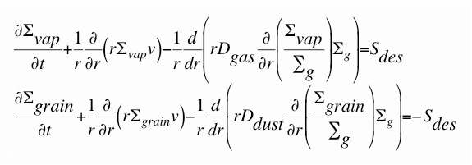
Basic Equations
Σ_{vap}, Σ_{grain} = surface densities of volatiles in gas and solid form
Σ_{g} = surface density of nebular gas
v = gas radial velocity
D_{gas} = gas diffusivity = viscosity
D_{dust} = dust diffusivity = D_{gas} / (1 + St^2)
S_{des} = source function of desorbed ices = f(Σ_{grain}, r, s, volatile properties)
Ciesla & Cuzzi (2006), Birnstiel et al. (2010, 2012)

Slide 24
Preliminary Results
Have solved the advection-diffusion equations without the source term => obtained the surface density evolution of solids (ignoring desorption for now)
Checked that results make sense physically

Slide 25
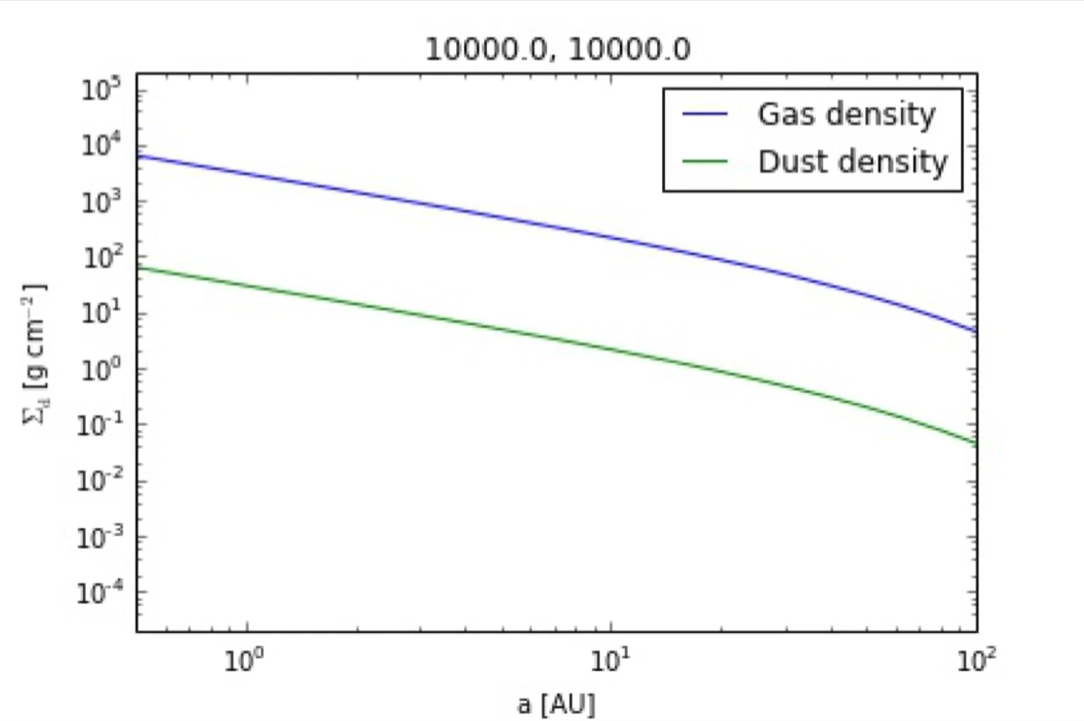
Determined profiles for gas and dust surface densities
s = 0.001 cm
alpha = 0.01, s = 0.001 cm

Slide 26
Determined profiles for gas and dust surface densities
s = 0.001 cm
alpha = 0.01, s = 1 km

Slide 27
Determined profiles for gas and dust surface densities
s = 0.001 cm
alpha = 0.01, s = 1 km
alpha = 0.01, s = 1 m

Slide 28
More preliminary results expected BEFORE defense

Slide 29
GOAL 2
Incorporate simple chemical evolution in coupled drift-desorption model
Collaborate with Ilse Cleeves
Results expected AFTER defense

Slide 30
Outline
Brief Background Info
Research Accomplished Since Last Meeting
Next Steps
Proposed Defense Timeline

Slide 31

GOOD NEWS
I have a job!

Slide 32
Thesis Outline
MAIN IDEA
The formation and composition of giant planets highly depends on disk location and properties.

Slide 33
Thesis Outline
Introduction
Minimum Core Masses for Giant Planet Formation at Wide Separations
Piso & Youdin 2014, ApJ, 786, 21
Piso, Youdin, & Murray-Clay 2015, ApJ, 800, 82
The Role of Disk Dynamics, Composition and Ice Morphology in Shaping Volatile Snowlines and the C/N/O Ratio
Piso, Oberg, Birnstiel, & Murray-Clay 2015, ApJ, 815, 109
Piso, Oberg, & Pegues 2016 (final stages)
The Effect of Time-Dependent Disk Dynamics on the C/N/O Ratio
Piso et al. 2016 (preliminary results as part of thesis)
Conclusion

Slide 34
Suggestions for External Examiner
Prof. Fred Ciesla (University of Chicago)
Dr. Margaret Pan (MIT)
Prof. Hilke Schlichting (MIT)

Slide 35
Thesis Timeline (and beyond)
GOAL
Officially graduate in spring 2016 => need to submit thesis to the registrar by May 13th

Slide 36
Thesis Timeline (and beyond)
By March 11th -> submit C/N/O paper
By March 25th -> apply for degree
March 11th – ~April 1st -> have some more preliminary results for the last thesis chapter
~April 1st – ~April 11th -> write thesis
Some time between April 25th and May 9th -> THESIS DEFENSE!
Mid-May – end of August -> develop intuition for chemistry and start developing a simple parameterized chemical network to implement in my dynamical model (collaborate closely with Ilse Cleeves)
End of August – early fall -> finish paper on last thesis chapter
September 1st -> START POSTDOC!

Slide 37
Conferences + Talks During Grad School
Past – 6 conferences (3 talks + 3 posters), 3 invited talks, 3 seminar talks
MIT Planetary Lunch Colloquium, Cambridge, MA, March 2016 -> Invited Talk
CfA Small Scale Seminar, Cambridge, MA, February 2016 -> Invited Talk
AAS 227th Meeting, Kissimmee, FL, January 2016 -> Dissertation Talk
Extreme Solar Systems III, Waikoloa, HI, December 2015 -> Poster
University of Michigan Lunch Talk, Ann Arbor, MI, November 2015 -> Contributed Talk
University of Chicago Exoplanet Journal Club, Chicago, IL, November 2015 -> Contributed Talk
MIT Exoplanet Tea, Cambridge, MA, September 2015 -> Contributed Talk
CIPS Seminar, Berkeley, CA, September 2015 -> Invited Talk
Star and Planet Formation in the Southwest, Oracle, AZ, March 2015 -> Contributed Talk
Protostars and Planets VI, Heidelberg, Germany, July 2013 -> Poster
IAUS 299: Exploring the Formation and Evolution of Planetary Systems, Victoria, BC, June 2013 -> Contributed Talk
Exoplanets in Multi-body Systems in the Kepler Era, Aspen, CO, February 2013 -> Poster
Future
ITC Luncheon, Cambridge, MA, April 2016 -> Invited Talk
Exoplanets I, Davos, Switzerland -> Contributed Talk (hopefully)

